Slide 1


Commercient SYNC ERP Integration for CRM
Sarvajanik College of Engineering & Technology
Master of Computer Applications
Present By:
Name: Nirmal Prajapati
Branch: MCA (Sem 4)
Enrollment No: ET22MTCA104
Guide By: Prof. Zankhana Vaishnav

Slide 2
Introduction
Commercient makes ERP and CRM integration really simple, quick, and efficient. Commercient has helped over 1000+ global companies seamlessly deploy enterprise integrations for ERP, CRM, Sales Automation (SA), and e-commerce by providing an “out of the box” integration solution that can be deployed rapidly with minimal services and overheads.
The integration platform synchronizes 150 + on-premise and cloud ERP systems, including NetSuite, Sage Intacct, Acumatica, Microsoft 365 AX, NAV, SL, Workday, IFS, INFOR, Epicor, ECi, Exact, SAP, Deltek, GlobalShop, IQMS, QAD, Syspro, Plex, QuickBooks, M2M, and many more.

Slide 3
Existing System
Before Commercient came along, connecting ERP and CRM systems was hard work for businesses. It took a long time to set up, cost a lot of money, and was very complicated.
Companies often had trouble making different systems work together, and there weren't any easy solutions available. This meant that every integration project was unique and didn't always work well. As a result, businesses couldn't use their systems effectively, which made it harder for them to get things done efficiently.

Slide 4
Need for the new System
Easy Data Management: Commercient helps businesses handle and track data easily.
Lots of Data: Businesses have a lot of data, and Commercient helps them handle it well.
Need for Efficiency: Modern businesses need tools like Commercient to work better.
Simplifying System Fusion: Commercient makes it easier for businesses to merge their ERP and CRM systems, ensuring a smoother integration process.

Slide 5
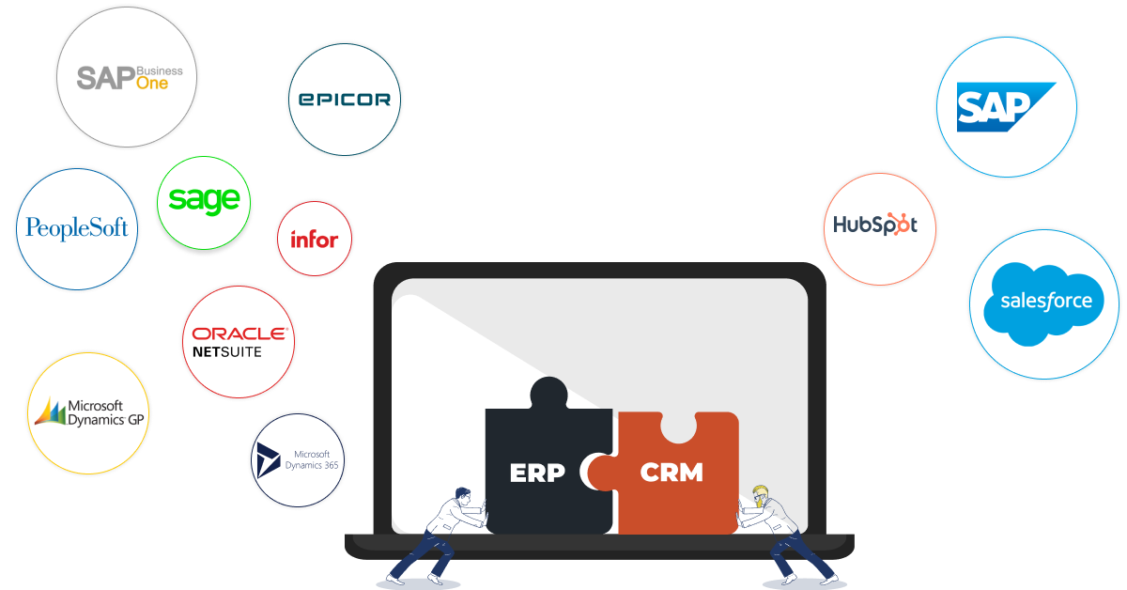
Why should you integrate them?

Slide 6
Why should you integrate them?
ERP (enterprise resource planning) software covers data across your organization. Most eCommerce businesses will benefit from an ERP system. including departments like accounting, human resources, procurement, supply chain management, eCommerce, and more. Examples include SAP, Oracle NetSuite, and Epicor Prophet 21.
Meanwhile, CRM (customer relationship management) platforms help sales and marketing teams. These systems manage information on prospects, customers, and former leads. Examples include Salesforce, HubSpot, and Microsoft Dynamics 365.
Larger businesses need both. CRM platforms have specialized features you won’t find in the most popular ERP software, and ERP covers a broader range of company-wide information that would be impossible to calculate with a CRM.

Slide 7
How it works
ERP to CRM
You can integrate your ERP data with your CRM system using our simple one-way SYNC app.
CRM to ERP
CRM data with your ERP system. Commercient SYNC is the easiest application to use to export your CRM data to your ERP system.
ERP And CRM SYNC
Commercient offers a two-way SYNC app designed to integrate both your ERP and CRM data together, creating one master system for easy data access.

Slide 8
Tools & Technologies
Frontend | Shopify, JavaScript, jQuery
Backend | ASP.NET Core, C#, Python
Database | Microsoft SQL Server
Cloud Storage | Amazon S3 Bucket
Development Tools | Visual Studio, VisualSVN, Windows Task Scheduler

Slide 9
Requirement Determination & Analysis
Functional Requirements
Data Synchronization: The system should facilitate bidirectional synchronization of data between ERP and CRM systems, ensuring consistency and accuracy across both platforms.
Customer and Sales Order Integration: Users should be able to synchronize customer information, sales orders, invoices, and payments between ERP and CRM systems seamlessly.
Product and Inventory Management: The system should support the integration of product catalogs, inventory levels, and pricing information between ERP and CRM systems.

Slide 10
Requirement Determination & Analysis
Functional Requirements
Opportunity and Lead Management: Users should be able to synchronize opportunity and lead data between CRM and ERP systems, enabling sales teams to track prospects and opportunities effectively.
Quote and Order Management: The system should enable the transfer of quotes and orders between CRM and ERP systems, facilitating efficient order processing and fulfillment.
Reporting and Analytics: Users should have access to integrated reporting and analytics capabilities, powered by AI-driven insights and predictive analytics models, to generate comprehensive reports and actionable insights based on data from both ERP and CRM systems.

Slide 11
Requirement Determination & Analysis
(B) Non-Functional Requirements
Security: The integration should implement robust security measures to protect sensitive data during transmission and storage, ensuring compliance with data protection regulations.
Performance: The integration should have optimal performance, with minimal latency and efficient data processing to support real-time synchronization between ERP and CRM systems.
Scalability: The integration should be scalable to accommodate growing data volumes and user loads, allowing for seamless expansion without compromising performance.

Slide 12
Requirement Determination & Analysis
(B) Non-Functional Requirements
Usability: The integration should be user-friendly, with intuitive interfaces and clear navigation to facilitate ease of use for employees accessing data across ERP and CRM systems.
Reliability: The integration should be reliable, with built-in error handling mechanisms and failover capabilities to ensure uninterrupted data synchronization and business continuity.
Compliance: The integration should comply with relevant industry standards and regulations, such as GDPR, HIPAA, and SOC 2, to ensure data privacy, security, and regulatory compliance.

Slide 13
Targeted Users
Commercient's target audience spans executives, sales representatives, finance teams, customer service, IT admins, marketers, and operations managers relying on ERP and CRM systems.

Slide 14
Benefits of SYNC
- Increased sales revenue
- Improved customer service
- Better decision-making
- Enhanced collaboration
- Better Analytics and Reporting

Slide 15
Limitations of SYNC
- Complexity and Cost
- Compatibility Issues
- Data Security Concerns
- Dependency on Vendor Support
- Change Management Challenges

Slide 16
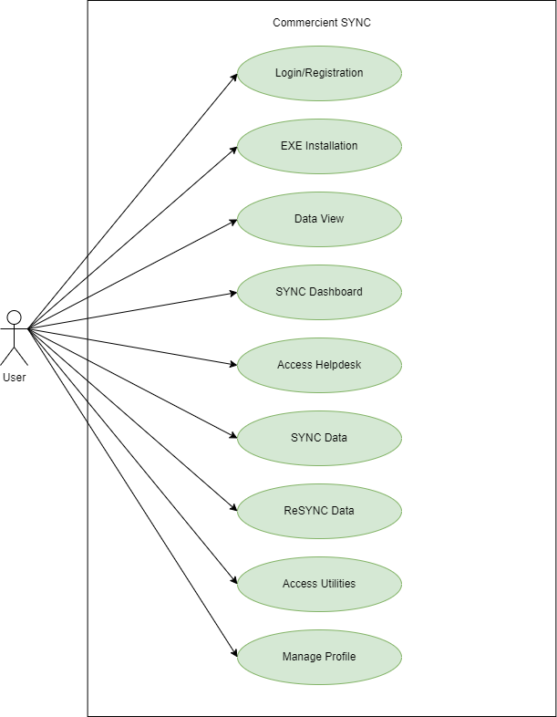
System Design
Use Case Diagram of User

Slide 17
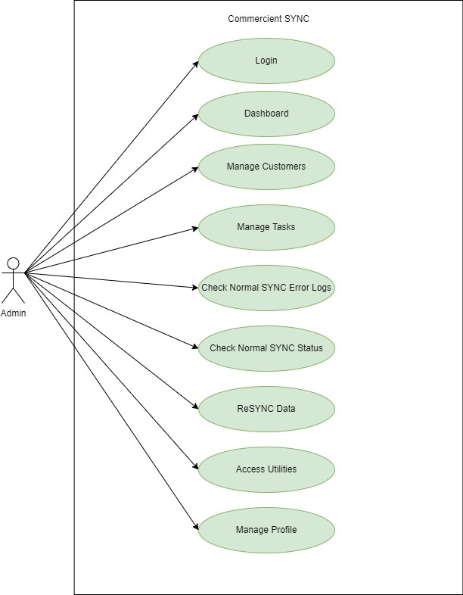
System Design
Use Case Diagram of Admin

Slide 18
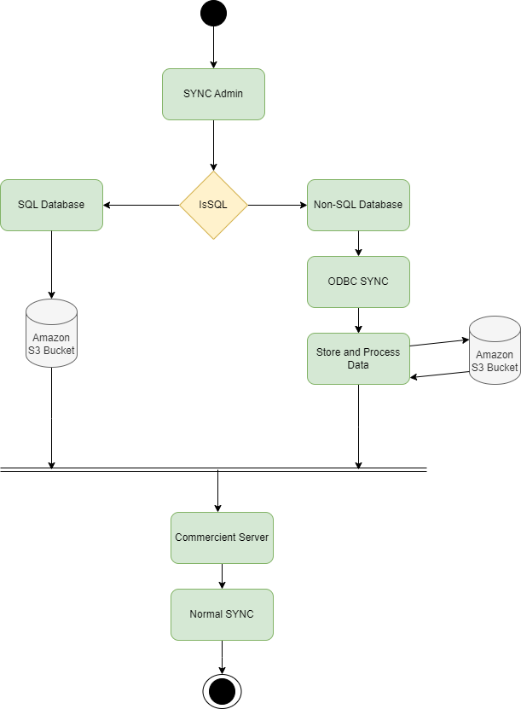
System Design
Normal SYNC Activity Diagram

Slide 19
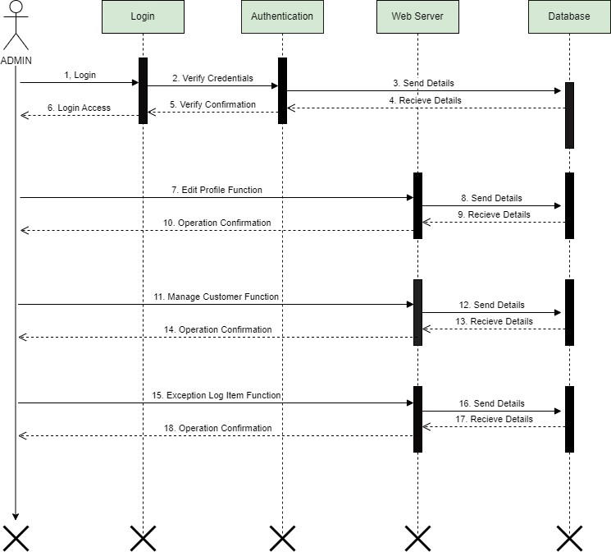
System Design
Interaction Diagram for Admin

Slide 20
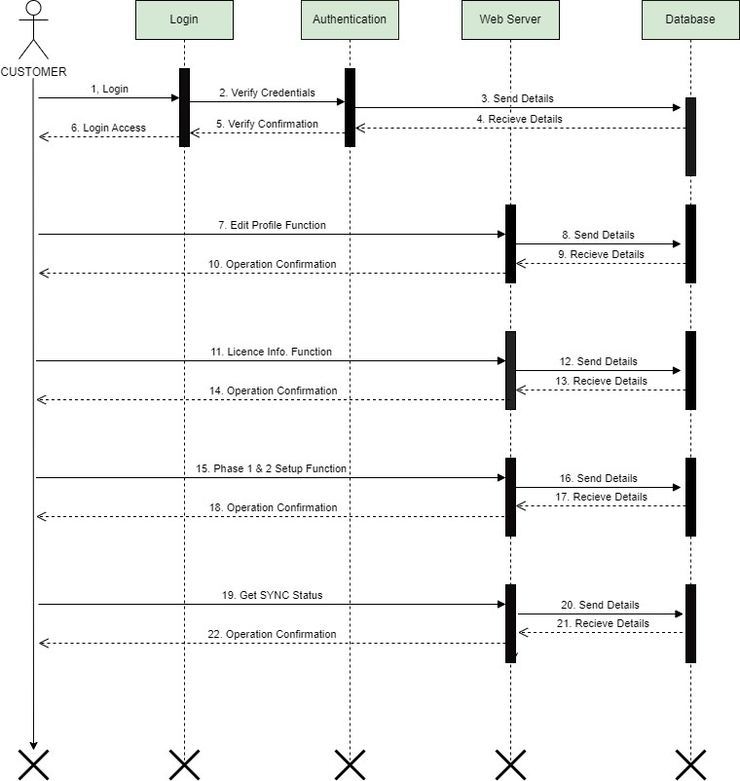
System Design
Interaction Diagram for Customer

Slide 21
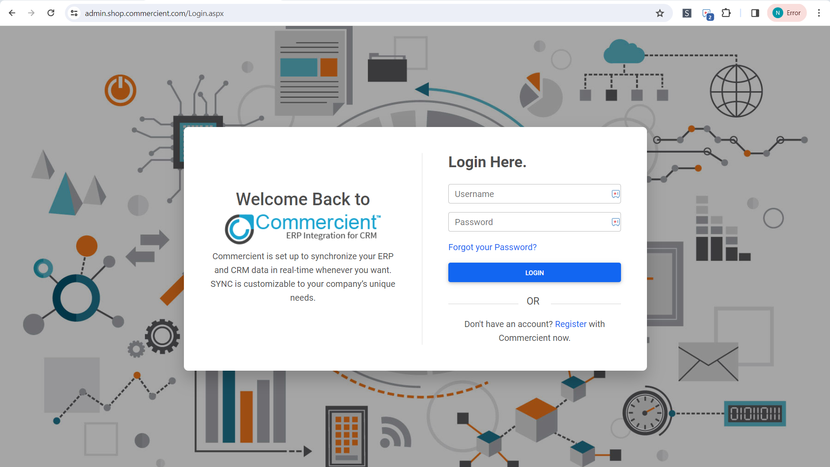
System Snapshots
Admin Login

Slide 22
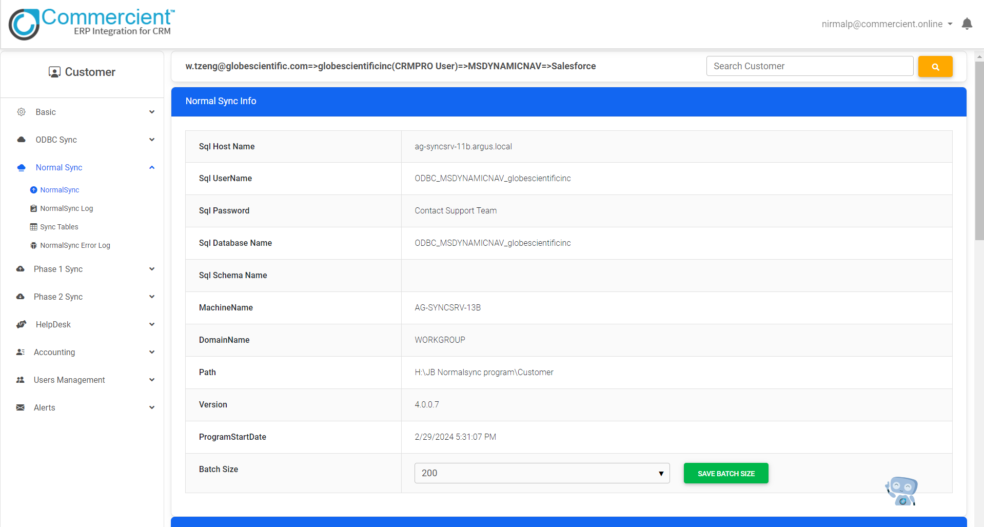
System Snapshots
Normal SYNC

Slide 23
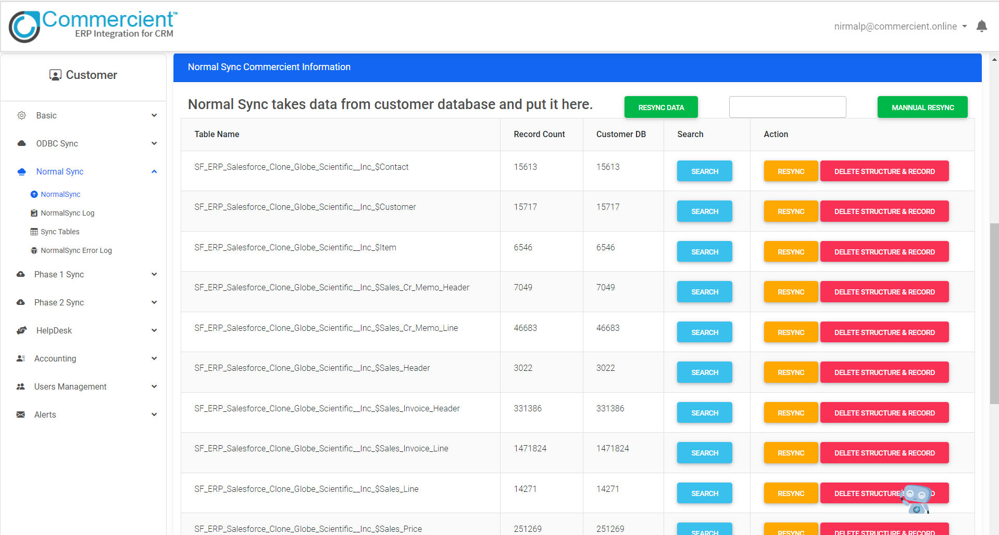
System Snapshots
Normal SYNC

Slide 24
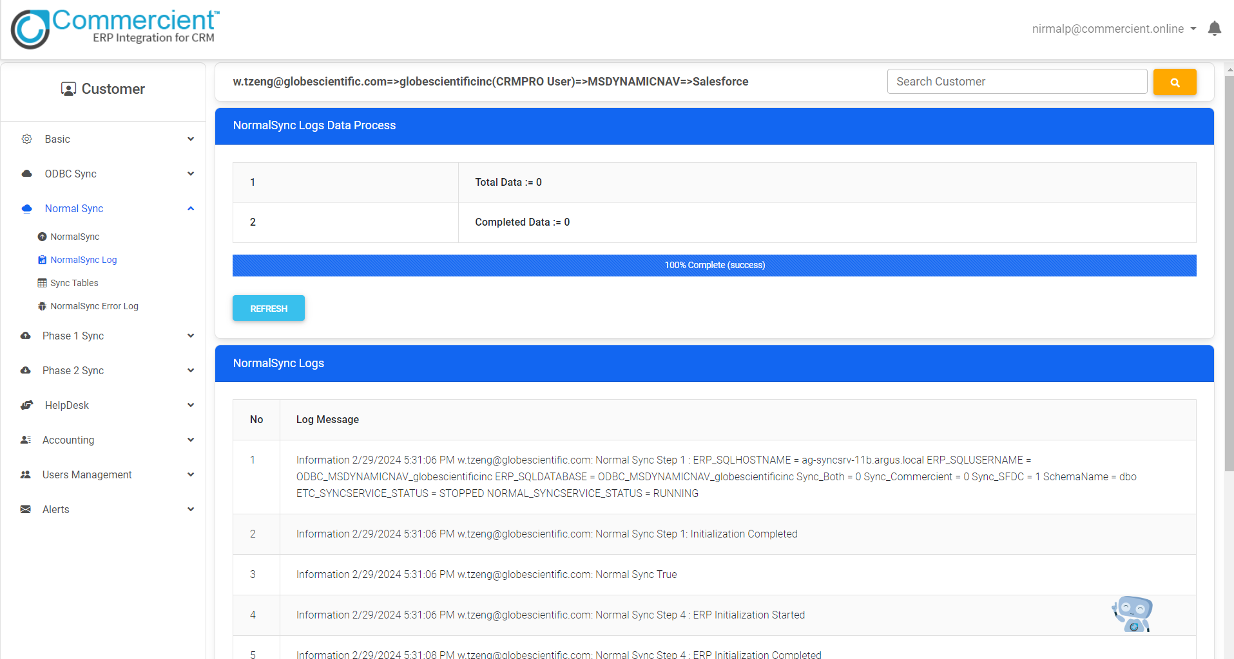
System Snapshots
Normal SYNC

Slide 25
System Snapshots
Normal SYNC

Slide 26
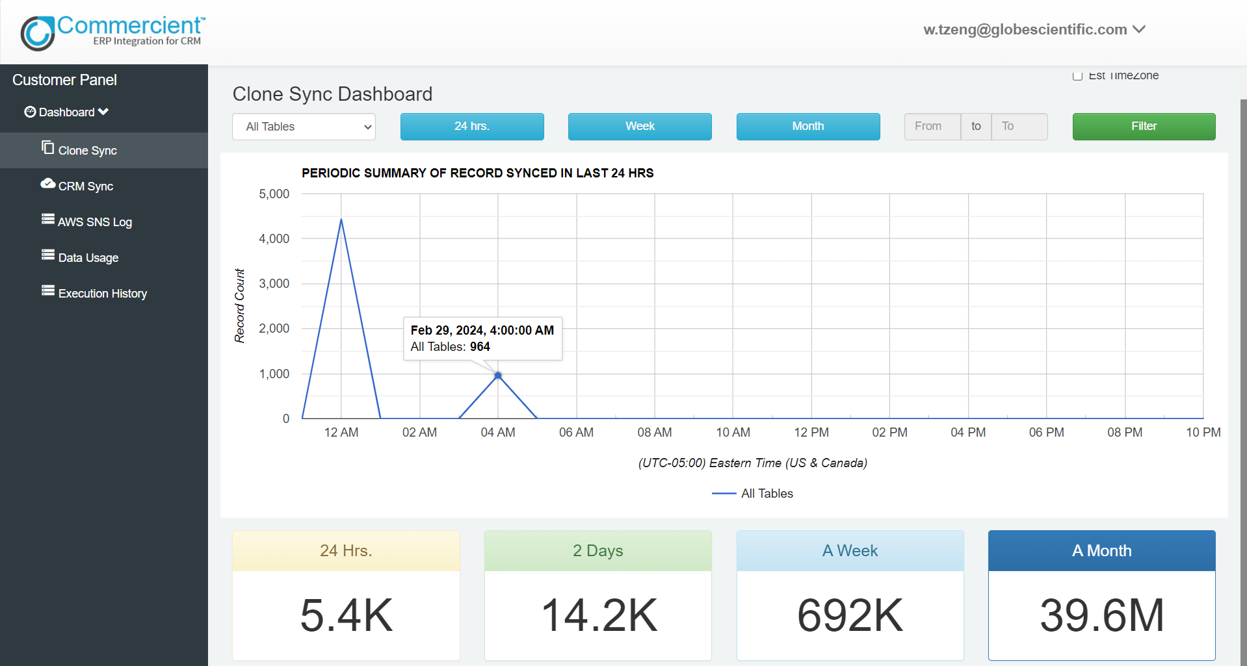
System Snapshots
Customer SYNC Dashboard

Slide 27
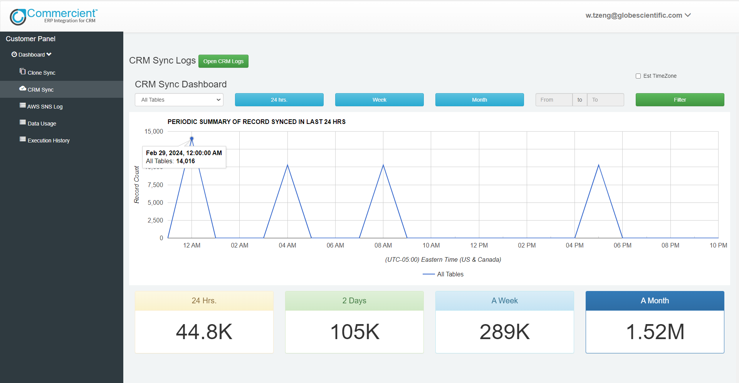
System Snapshots
CRM SYNC Dashboard

Slide 28
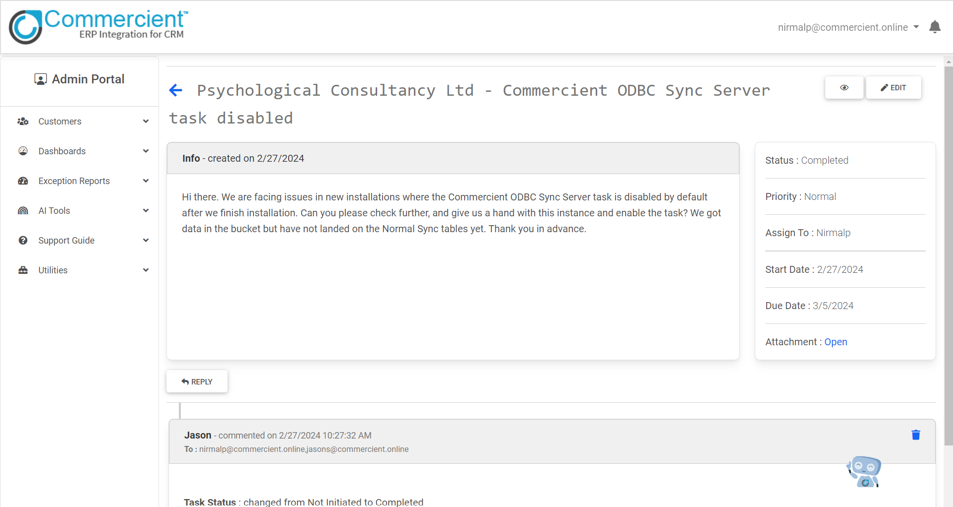
System Snapshots
Mojo Tickets

Slide 29
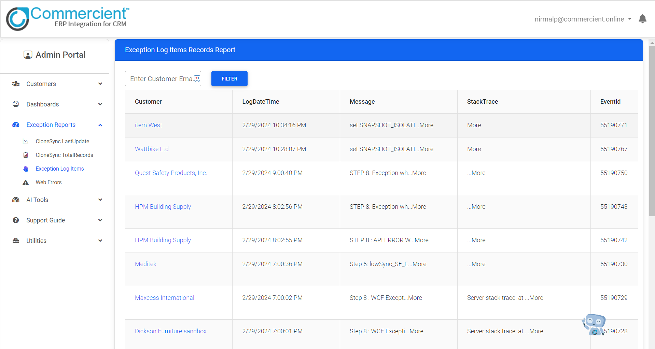
System Snapshots
Exception Logs

Slide 30
Proposed Enhancement
In Existing system, if the customer have problem with sync they refer the blogs or documentation but in proposed system, the latest LLM Model works on the previous tickets and documents and based on that data providing the solution and automate the sync process also predicts the future tends and increase the sales.

Slide 31
Conclusion
In conclusion, the CRM and ERP integration tool offers streamlined operations, informed decision-making, and enhanced customer engagement. By combining CRM and ERP functionalities seamlessly, it provides organizations with a comprehensive solution to optimize processes and stay competitive in the market.

Slide 32
Bibliography
https://dotnet.microsoft.com/en-us/learn/dotnet/
https://developer.salesforce.com/docs
https://www.zoho.com/crm/help/
https://learn.microsoft.com/en-us/sql/?view=sql-server-ver16
https://www.hubspot.com/products/crm
https://www.sap.com/india/products/erp/what-is-sap-erp.html
https://www.youtube.com/channel/UC92x63Cete3v0erwL3JOJEA

Slide 33
Thank you

